Slide 1
Unit 4.5
Teacher: iddo sadeh

Slide 2
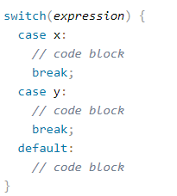
Switch statements
*taken from https://www.w3schools.com/java/ref_string_compareto.asp
Notes:
When Java reaches a break keyword, it breaks out of the switch block.
The default keyword specifies some code to run if there is no case match:

Slide 3
Character class
When we work with characters, we use the primitive data type char
In Java characters have Unicode values
Some situations are easier if we use the wrapper class Character instead of a primitive data type
Creating a character object is similar to creating other objects
When using Character methods on char data types, the compiler will normally auto “translate” them in to objects.

Slide 4

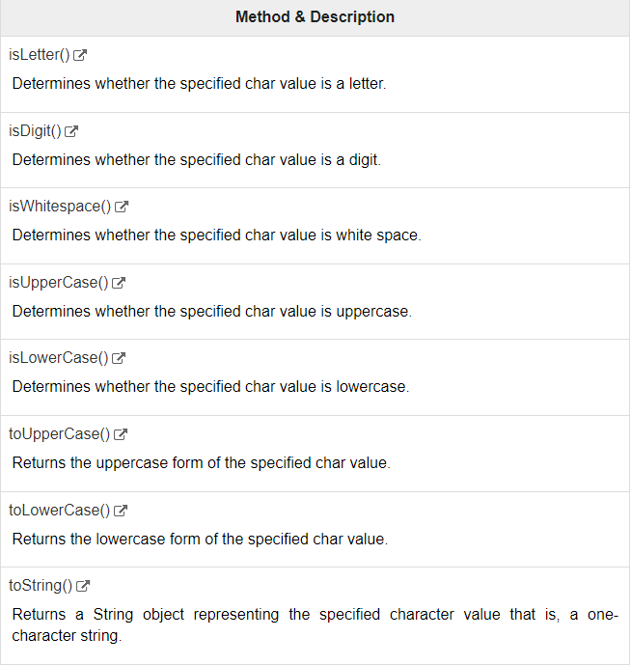
Common character methods
* Taken from https://www.tutorialspoint.com/java/java_characters.htm

Slide 5
Compareto method
The compareTo() method compares two strings lexicographically.
The comparison is based on the Unicode value of each character in the strings.
The method returns 0 if the string is equal to the other string. A value less than 0 is returned if the string is less than the other string (less characters) and a value greater than 0 if the string is greater than the other string (more characters).
*taken from https://www.w3schools.com/java/ref_string_compareto.asp

Slide 6
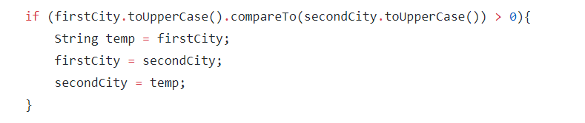
example
*taken from https://github.com/mlnorman/Intro-To-Java-Programming/blob/master/Chp4/Exercise_04_24.java

